Slide 1
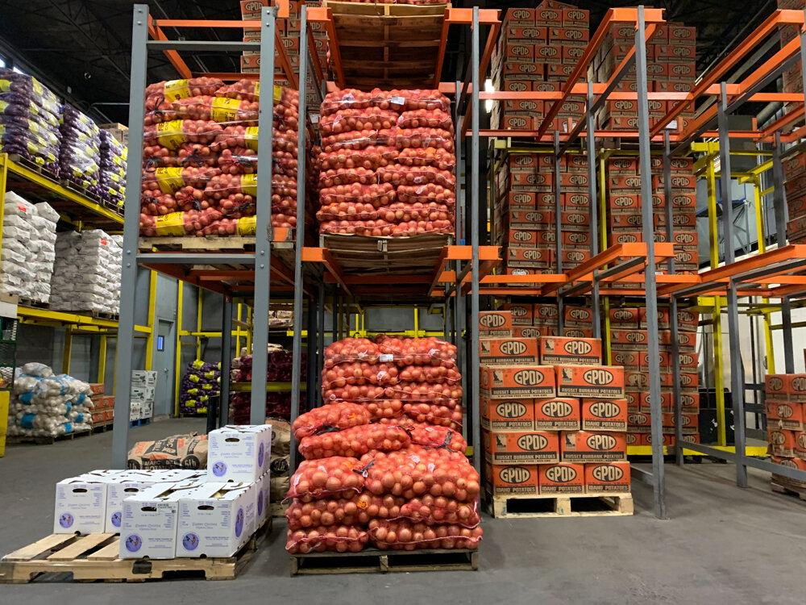



Food Insecurity in the United States of America
By A. Nicole Mosley, Ivette Sierra, & Natalin Williams

Slide 2

MEET “THE FAB 3”
DATA SCIENTISTS

Slide 3


A. Nicole Mosley
Bachelors in Political Science (International Relations), Minor in Economics
Previously employed by U.S. Census Bureau, logistics companies; interned with D.C. Executive Office of the Mayor
Experience in human resources, research, administrative and program support, international travel
Looking to apply Data Science expertise to political consulting

Slide 4
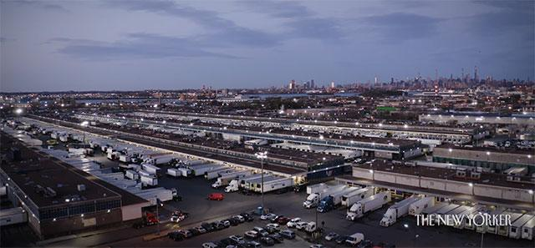

Ivette Sierra
Graduated from John Jay College of Criminal Justice with a Bachelor of Science Degree in Criminal Justice
10 years experience as a Law Enforcement Officer with the NYC Parks Dept., NYPD School Safety Agent, & in the private sector as a Public Safety Officer with the Hunt’s Point Produce Terminal Market.
Looking to obtain a position as a Data Scientist in the Criminal Justice field or in Public Administration.

Slide 5


Natalin Williams
20 years in retail, compounding, and hospital pharmacy settings as a certified pharmacy technician, manager, and inventory specialist
10 years as business owner of wellness company and photography company
Former interior designer and project manager of a Birmingham metro construction company
Volunteer for local children’s outreach programs
Data science is the perfect fit for my love for research, design creativity, management skills, and local outreach programs

Slide 6
Why Care About Food Insecurity?

Slide 7

When The News Headlines Become All Too Real
Our Backgrounds
Pharmacy
Logistics
Politics
Our Observations
Noticing increased prices of everyday expenses, particularly food/groceries, gasoline, and utilities
Witnessing lack of food/resources in lives of our friends, neighbors, fellow citizens

Slide 8
Uncovering Food Insecurity

Slide 9
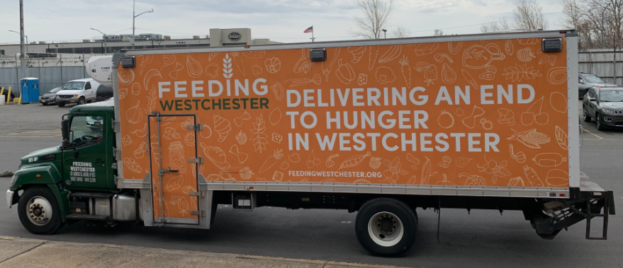
What is Food Insecurity?
Lack of consistent access to enough food for every person in a household to live an active, healthy life
Can be a temporary situation for a household or can last a long time
Indicator to measure how many people cannot afford food
Feeding America: As many as 42 million Americans (1 in 8), including 13 million children (1 in 6), may have experienced food insecurity in 2021
Feeding America, 2022

Slide 10
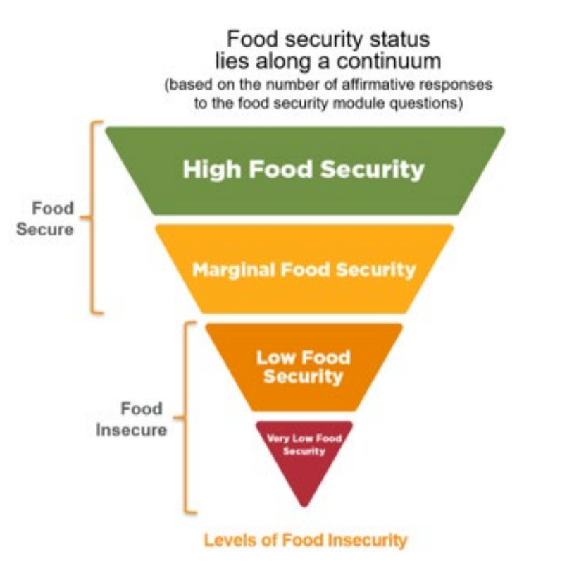
Feeding America, 2022

Slide 11
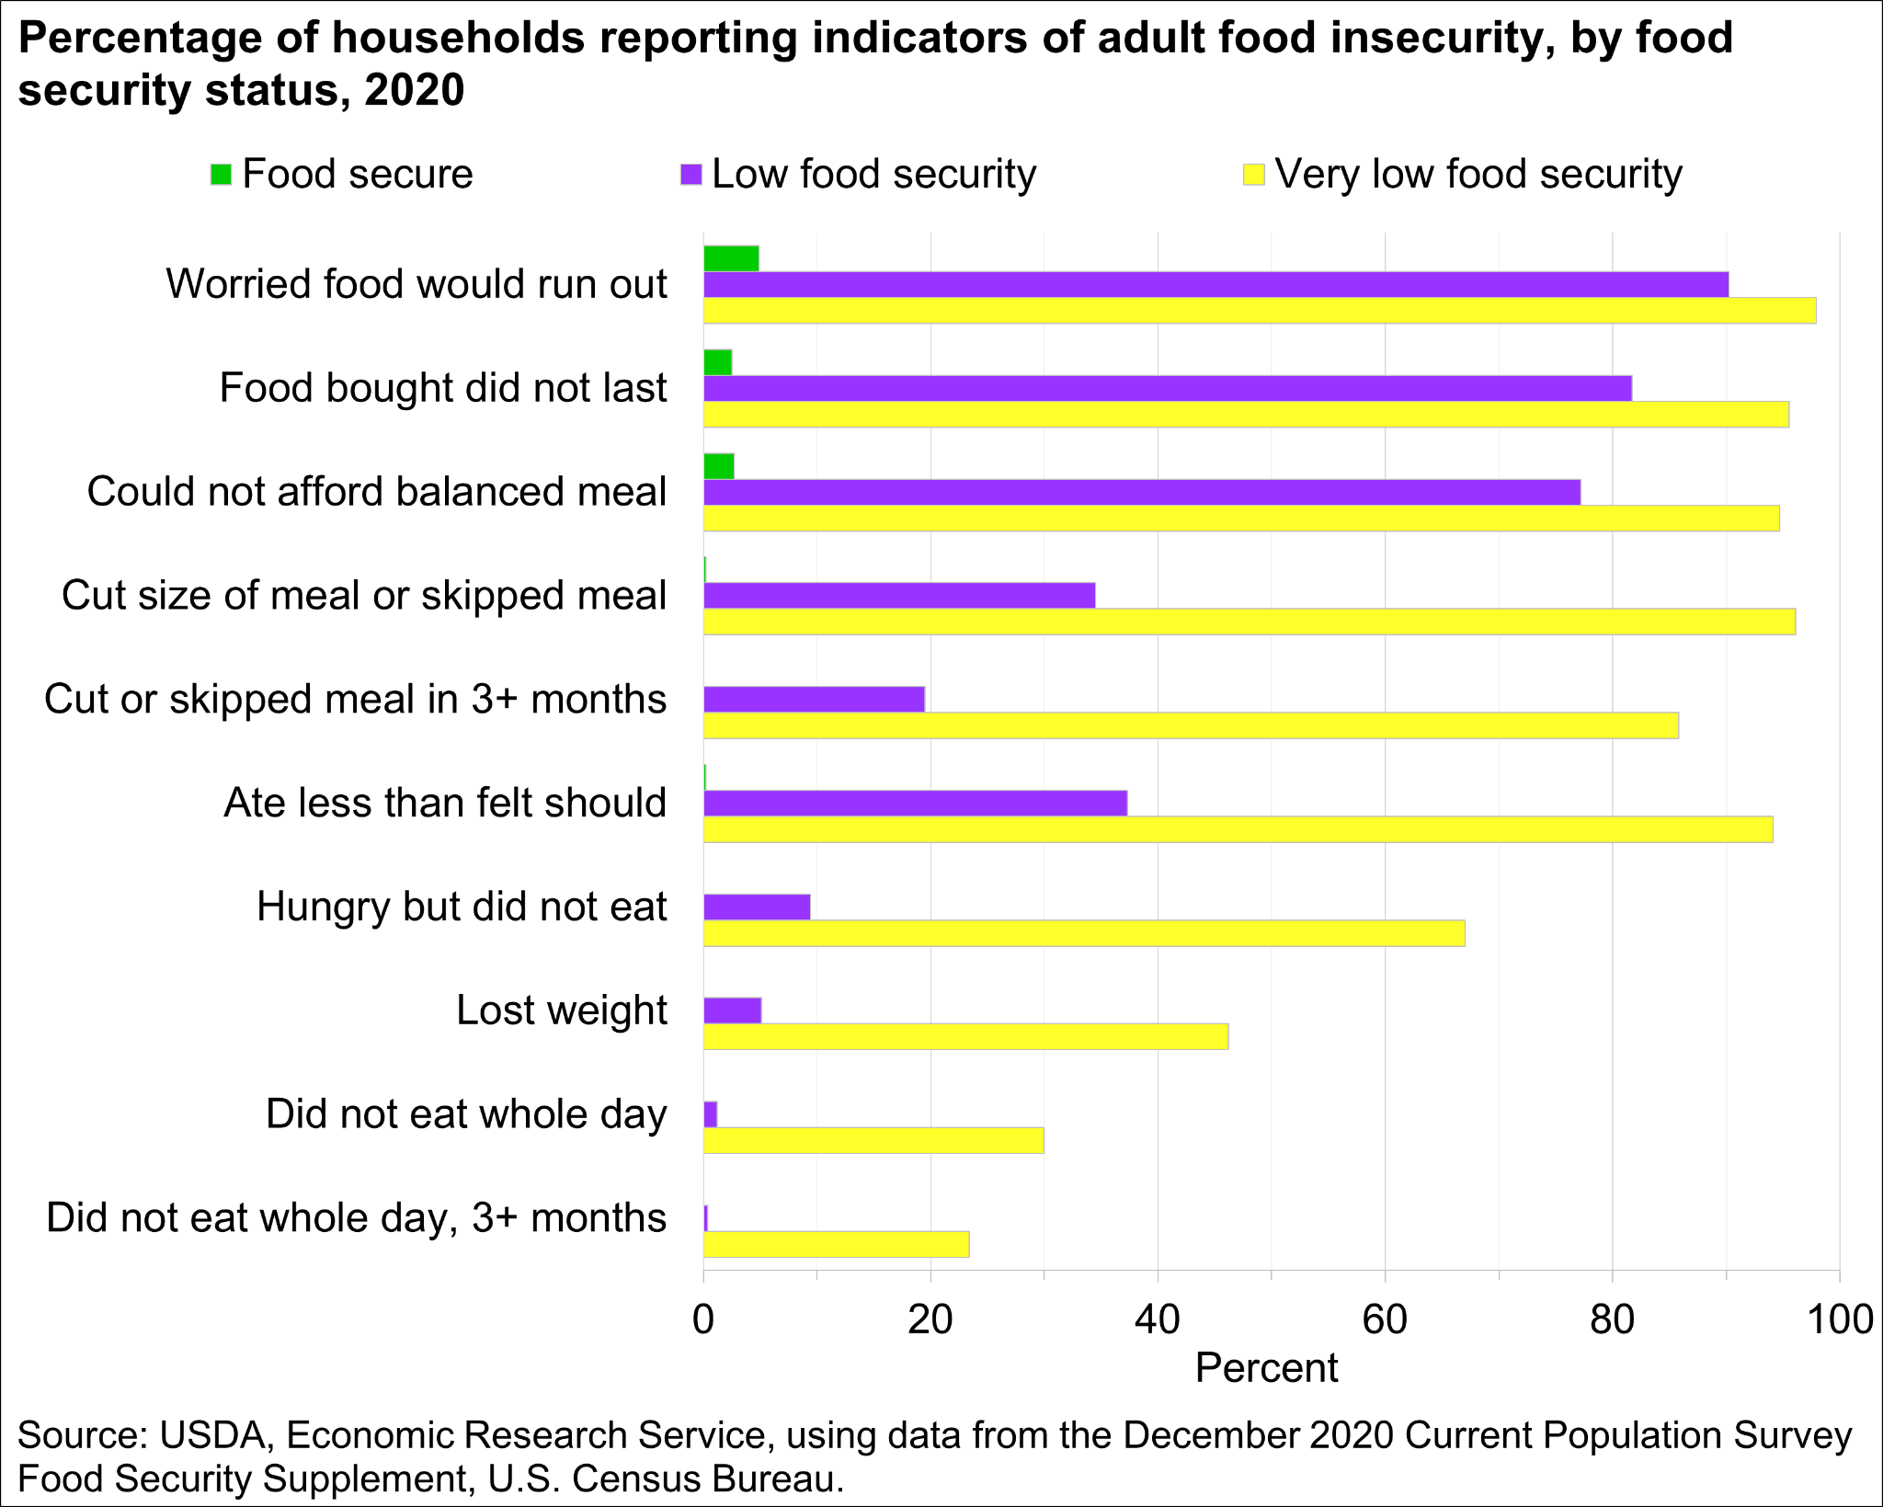
2020 U.S. Census Food Security Survey
Feeding America, 2022

Slide 12
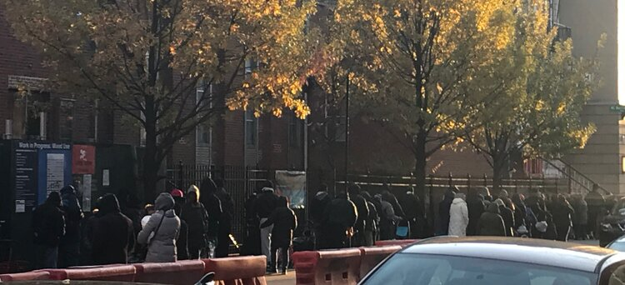
What Are the Causes and Effects of Food Insecurity?
Poverty, unemployment, low income
Not enough affordable housing
Chronic illness, serious health conditions/complications, or gaps in access to healthcare
Systemic racism and racial discrimination
Delayed child development
Having to prioritize financial obligations: rent or food?

Slide 13
Approach/Methods

Slide 14

Week One :
Project Planning
Brainstorming
Dataset “Scavenger Hunt”
Food insecurity
Child food insecurity
Population below poverty
Regional Price Parities
Unemployment
Inflation
Locate all relevant research
Choosing a specific topic?

Slide 15

Week Two :
Data Wrangling
Python, RStudio
Removed missing data and all NaN values
Trimmed datasets
Subsetted and categorized data for easier manipulation and analysis
Altered data types from/to float, string, factor, integer, numeric, category
Recoded data categories as needed
How was data cleaned and prepared for analysis?

Slide 16
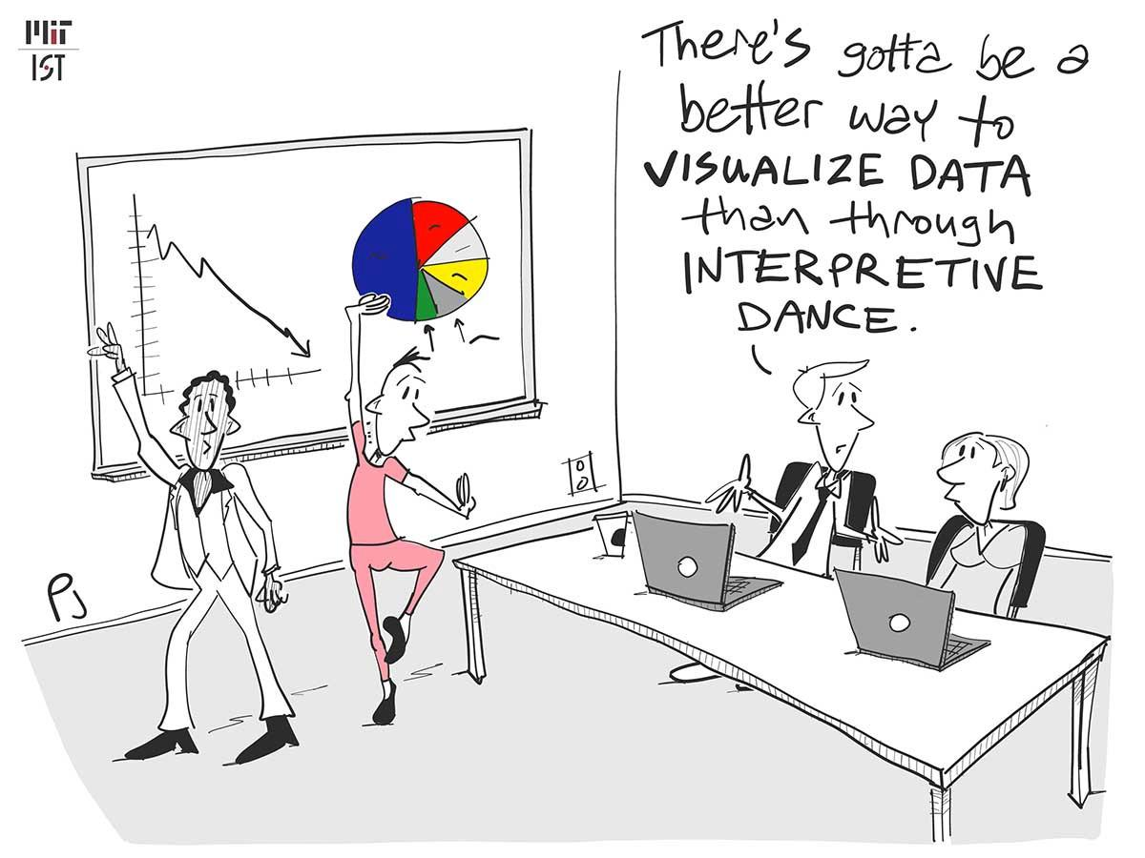
Weeks Three-Four-Five
Exploratory, Data Analysis, and Data Visualization
Python, RStudio
Correlation Matrices
Correlation Heat Maps
Histograms
Boxplots
Bar Graphs
Scatterplots
Linear Regression
Tableau
Bar Charts
Line Graphs
Geographic Graphs
Excel
Dependent t-Test
Line and Bar Charts
How was the data best interpreted?

Slide 17
Dynamics of Food Insecurity
Primary Causes: poverty, unemployment, underemployment, geography (affecting access to whole/nutritious food), food prices, inflation - makes phenomenon difficult to solve
On national level, monitored by agencies such as:
U.S. Department of Agriculture - Economic Research Service (USDA-ERS)
Feeding America
U.S. Census Bureau
Other agencies with supporting statistics:
Bureau of Economic Analysis (BEA)
Bureau of Labor Statistics (BLS)
Feeding America, 2022

Slide 18
Results -
Food Insecurity Trends

Slide 19
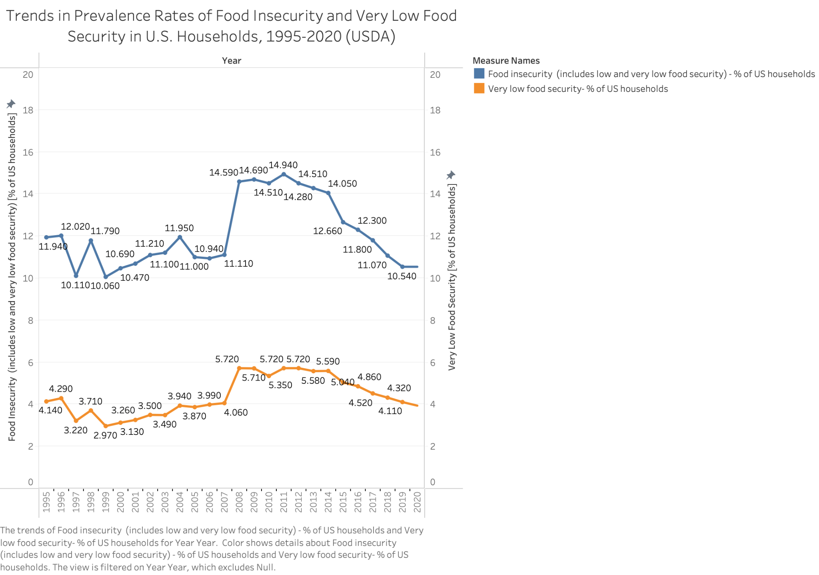
Before the start of the pandemic, the overall food
insecurity rate had reached its lowest point since it began to be measured in
the 1990s, but…
Covid-19 threatened to upend progress
Although more recent reports indicate that food security appears to be steadily increasing, will added pressures threaten this?

Slide 20
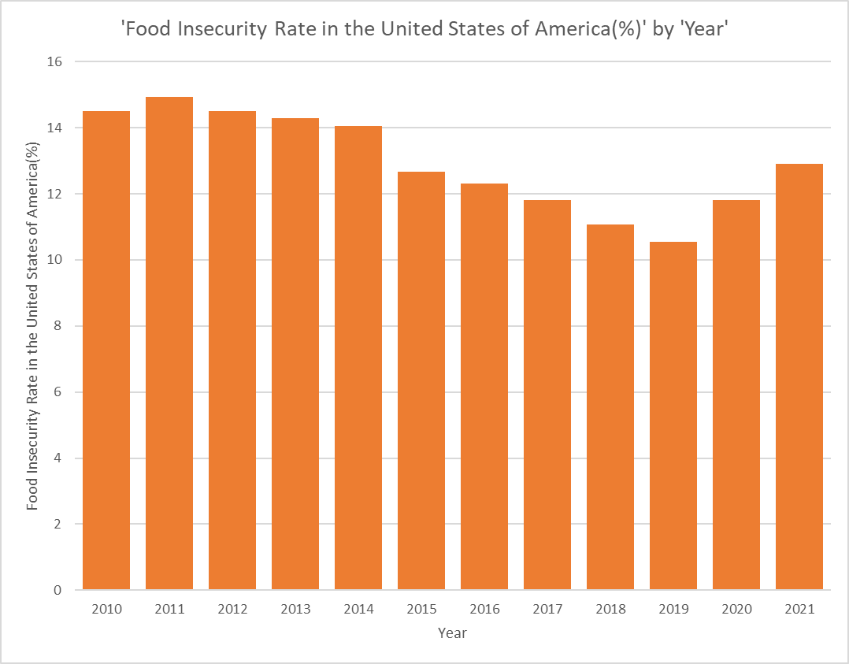
Food Insecurity Actual(%) Years 2010-2020 and 2021(Projected %)

Slide 21

Timeline
Great Recession (2007-2009)
Big Changes in Trucking Industry
Global Upheaval
Onset of Covid-19 Pandemic and Recession
Recovery or Not?: The Big Standstill
Dec. 2007-June 2009: Economic downturn after bursting of housing bubble and global financial crisis
Food insecurity levels grew beyond poverty rate; traditionally closely tied
Inflation rate range: -0.4 -3.8%
Trucker population went from 7.65 million to 3.36 million, a decrease of 6.8% from 2019
April 2020: unemployment at all-time high of 14.8% since 1948; labor force participation rate fell to 60.2%
Partial recovery in May 2020
Inflation rate: 1.23%
Current war in Ukraine threatens global food crisis, crucial portion of the world’s wheat, corn, barley, fertilizer trapped in region, leading to rising prices
Following CV-19, inflation rate has reached 7%, highest in decades
Natural Disasters
2019
2021
2007
2020
2022
Feb 2020: Although national food insecurity rate was lowest in 20 years (10.54%), the pandemic has presented another significant setback
Between 2018-2019, total U.S. agricultural exports fell in value from 144.7 billion to 141.2 billion, decrease of 2.4%; and from 219.7 million metric tons to 199.5 million metric tons (loss of 9.2%)
Inflation rate of 1.81%
March 2021: Ever Given Shipping Container Blockage, Computer Chip Factory Fire
July 2021: Labor force participation rate at 61.7%
July 2021: Unemployment remained higher (5.4%) than it had been in Feb 2020 (3.5%)
Inflation rate: 4.7%

Slide 22
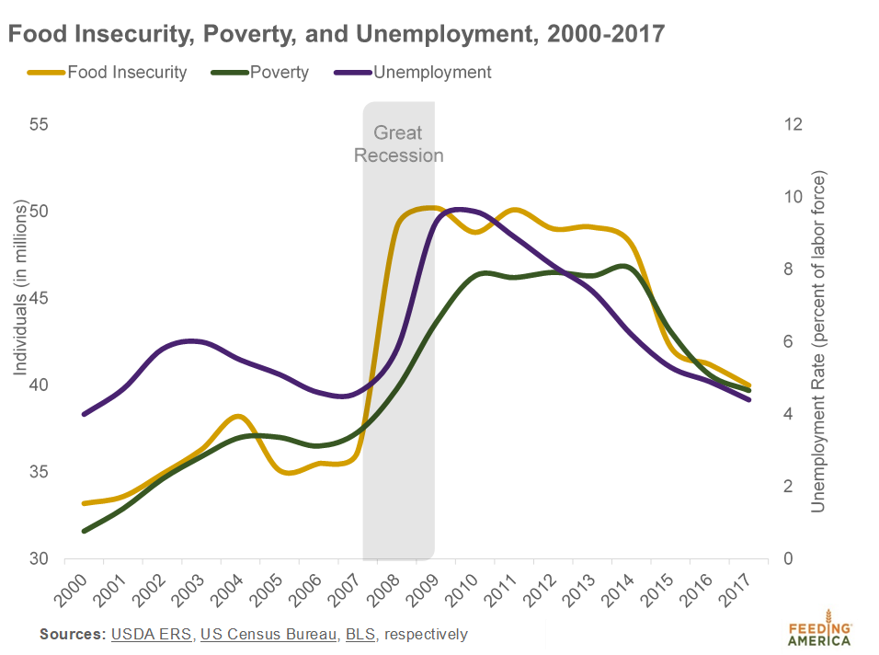
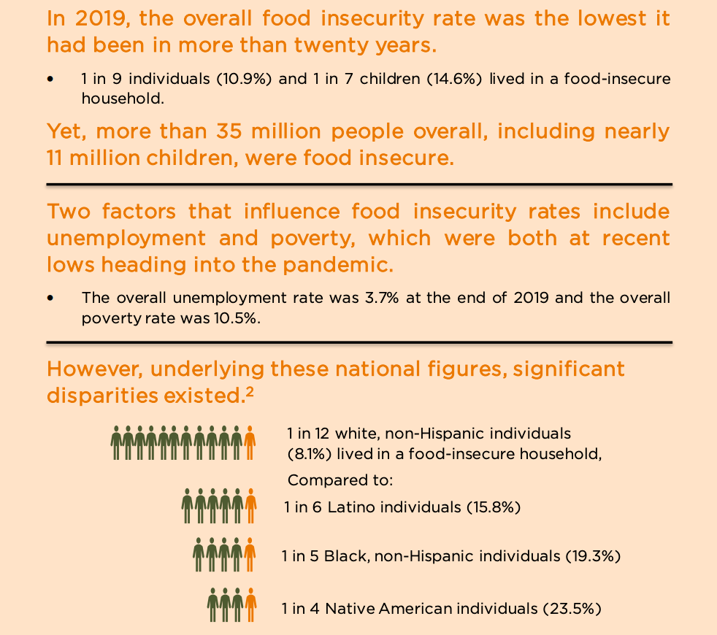
Hunger, Poverty, and Unemployment
Feeding America, 2018; 2021

Slide 23
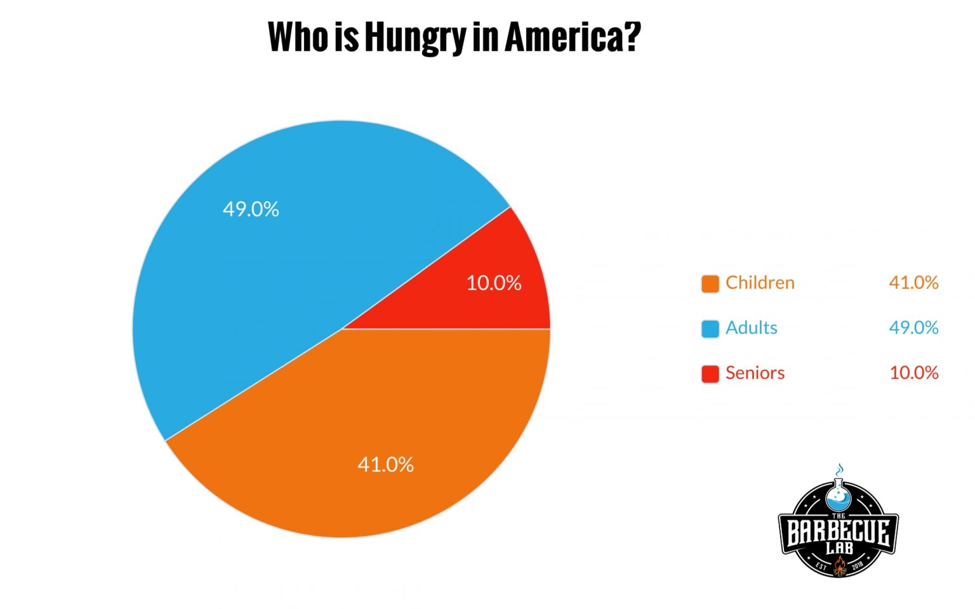
Who is Hungry in America in 2021/2022?
The Barbecue Lab: Of 330 million Americans, approximately 41 million people total (12% of population) struggle with hunger
20 million adults
16 million children
4.1 million seniors
Feeding America projections slightly unchanged btwn 2019 and 2021
1 in 5 Black individuals (19.3% to 21.3%)
1 in 10 to 1 in 9 white individuals (9.6% to 11.1%)
The Barbecue Lab, 2022

Slide 24
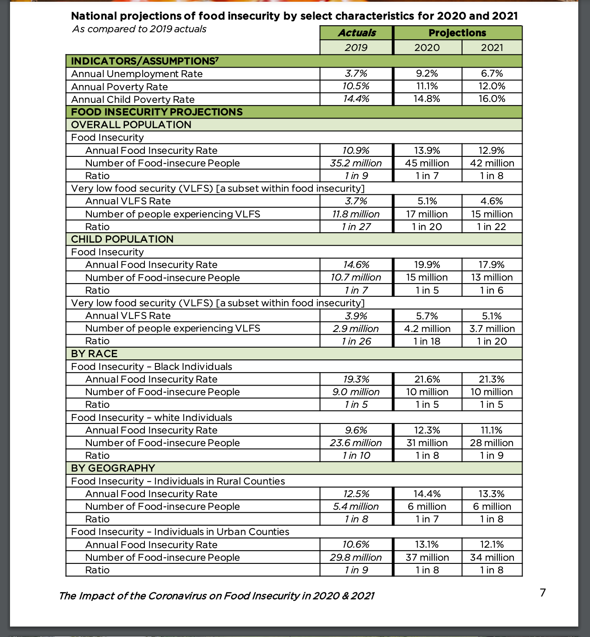
 | 2019 | 2020 | 2021
FI rate (individual not household) | 10.9% | Projected: 13.9% Actual: 11.8% | Projected: 12.9% Estimated Actual (by The BBQ Lab): 12%
# of FI people (overall pop) | 35.2 million | Projected: 45 million Actual: > 38 million | Projected: 42 million Estimated Actual (by The BBQ Lab): 41 million
# of FI people (child pop) | 10.7 million | Projected: 15 million Actual: 11.7 million | Projected: 13 million Estimated Actual (by The BBQ Lab): 16 million
Feeding America, 2021; The Barbecue Lab, 2022

Slide 25
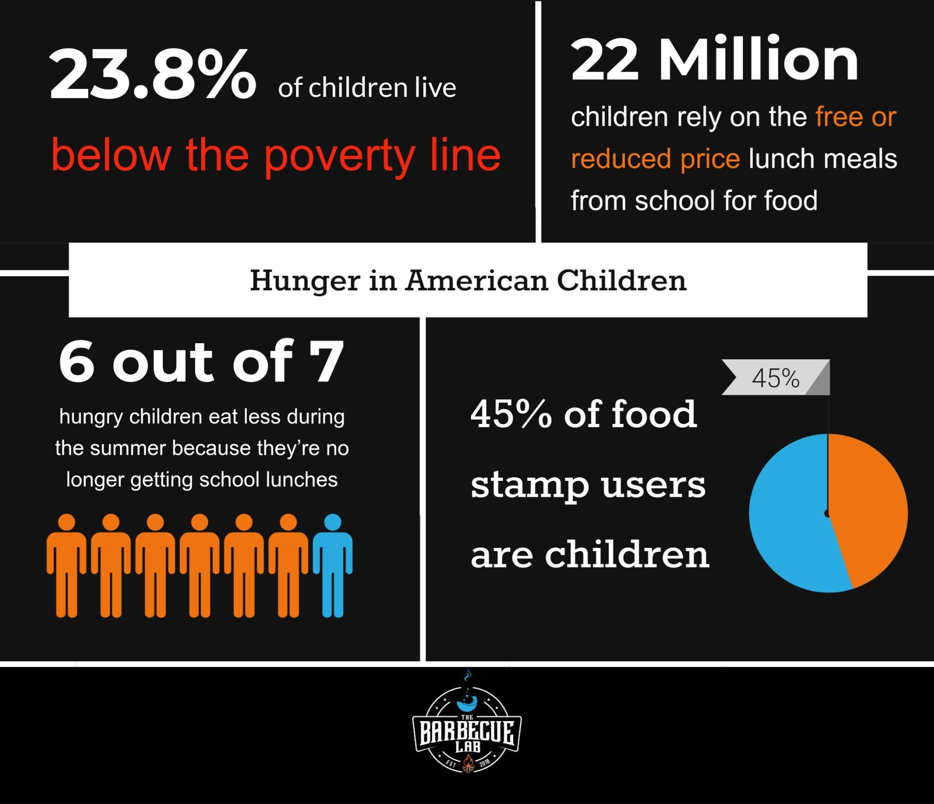
Stats on Children Experiencing Hunger
The Barbecue Lab, 2022

Slide 26
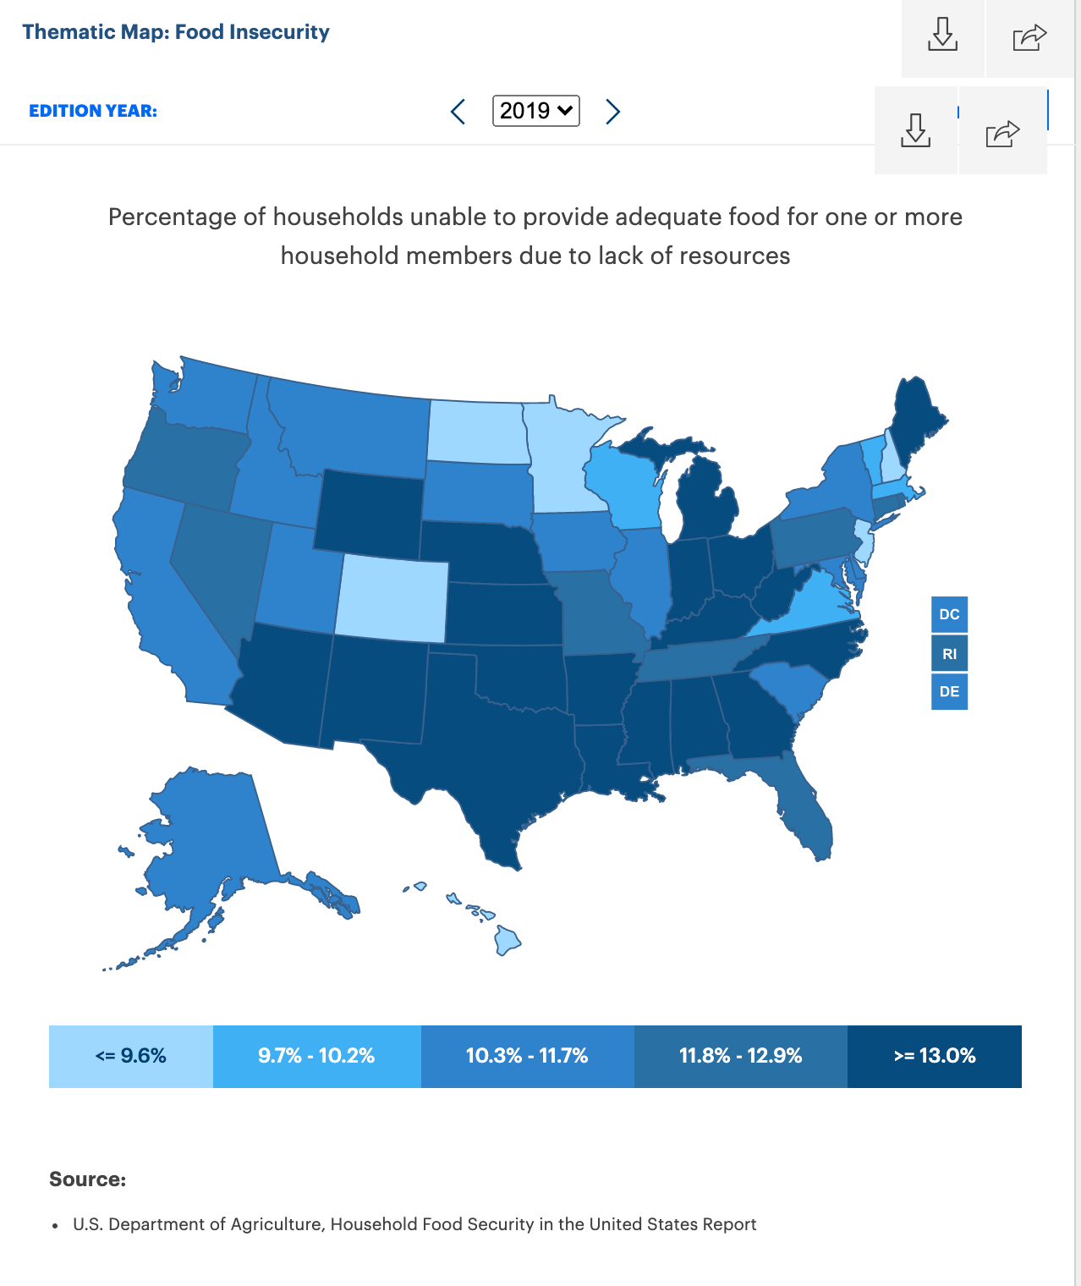
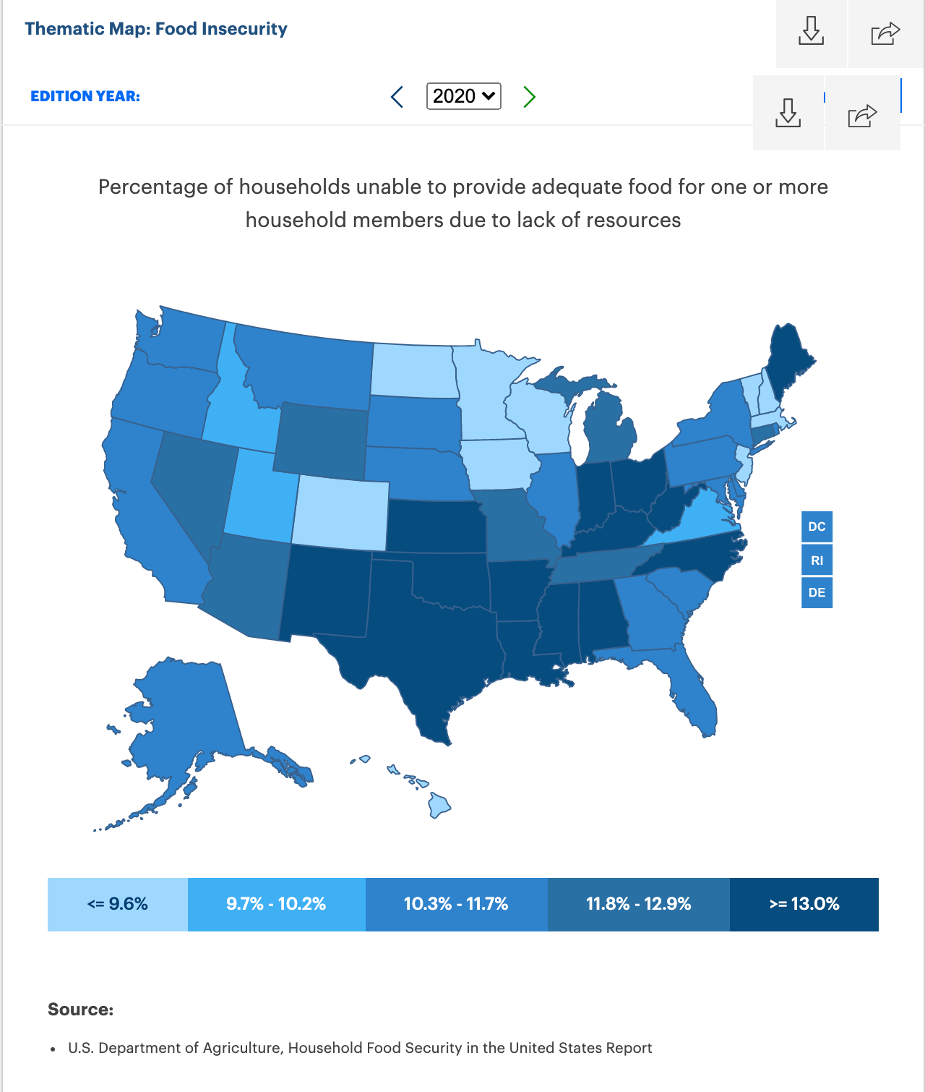
Thematic Map: Food Insecurity
2019
2020
United Health Foundation, 2022

Slide 27
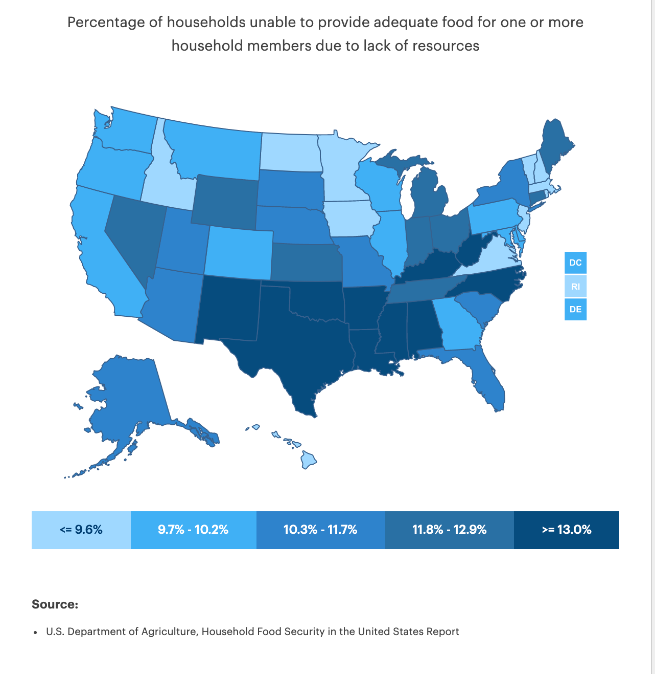
Thematic Map: Food Insecurity
2019
2021
United Health Foundation, 2022

Slide 28
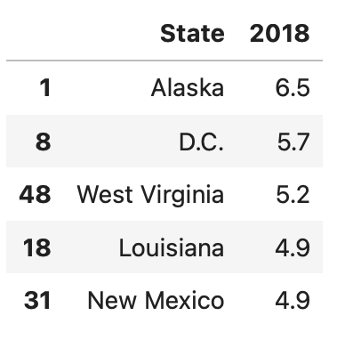
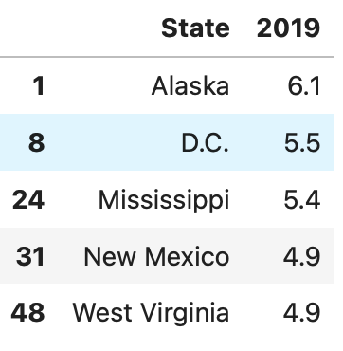
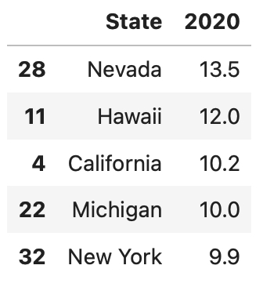
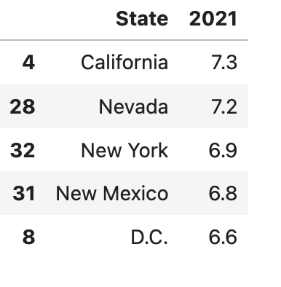
Top Five States For Food Insecurity and Unemployment
2019 | 2020 | 2021
New Mexico - 17.9% | New Mexico - 16.8% | Mississippi - 15.7%
Arkansas - 17.4% | Mississippi - 15.9% | West Virginia - 15.4%
Louisiana - 17.3% | Louisiana - 15.8% | Louisiana - 15. 3%
Mississippi - 17.2 % | West Virginia - 15.7% | New Mexico - 15.1%
Alabama - 16.3% | Oklahoma - 15.6% | Oklahoma - 14.7%
 | 2018 | 2019 | 2020 | 2021
Highest Unemployment

Slide 29
Top Five States For Food Insecurity and Poverty
2019 | 2020 | 2021
New Mexico - 17.9% | New Mexico - 16.8% | Mississippi - 15.7%
Arkansas - 17.4% | Mississippi - 15.9% | West Virginia - 15.4%
Louisiana - 17.3% | Louisiana - 15.8% | Louisiana - 15. 3%
Mississippi - 17.2 % | West Virginia - 15.7% | New Mexico - 15.1%
Alabama - 16.3% | Oklahoma - 15.6% | Oklahoma - 14.7%
States With Highest Poverty Rates (2016-2020)
Mississippi - 19.58% |  |  | West Virginia - 15.7%
Louisiana - 18.65% |  |  | Kentucky - 16.61%
New Mexico - 18.65% |  |  | Arkansas - 16.08%
U.S. Census Bureau, American Community Survey (2016-2020)

Slide 30
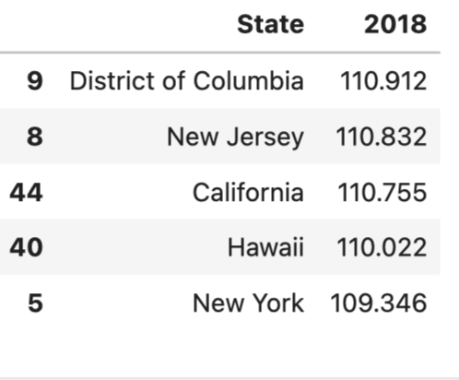
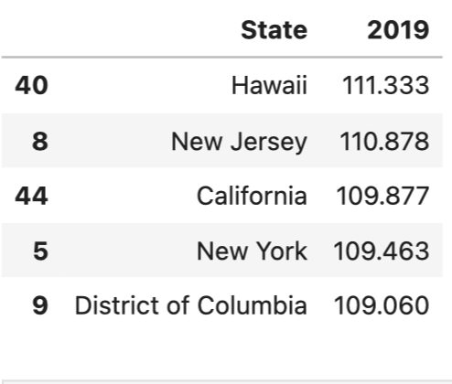
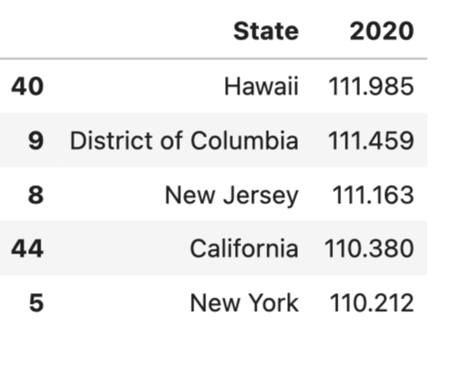
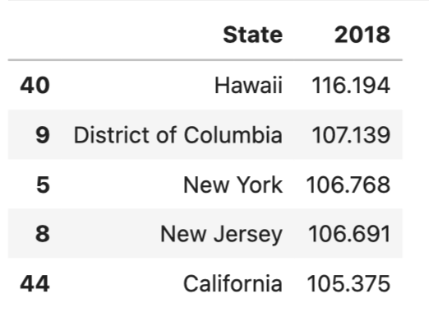
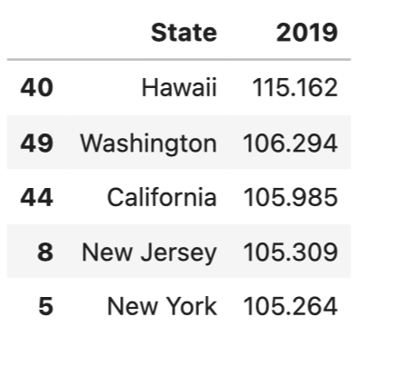
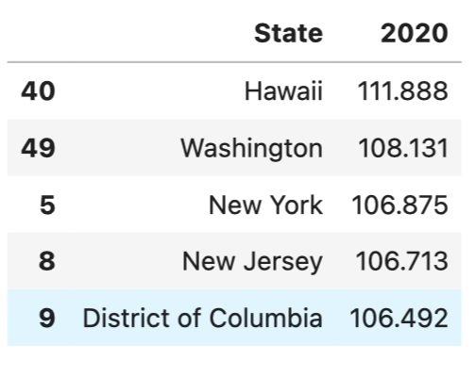
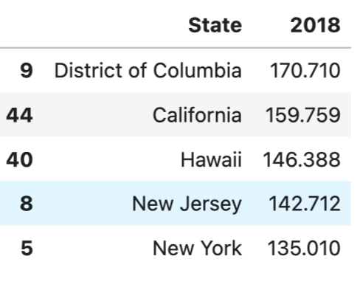
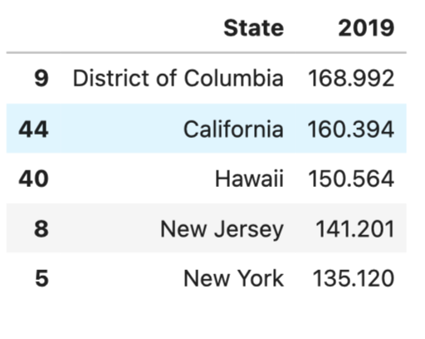
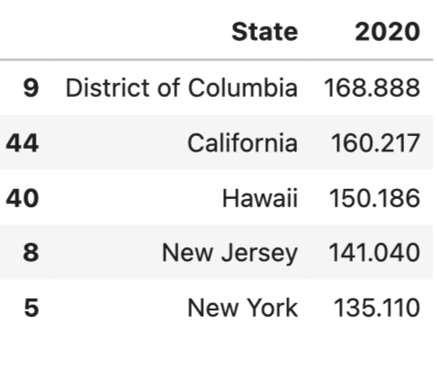
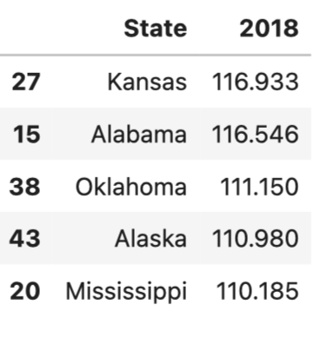
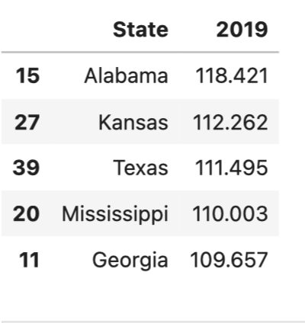
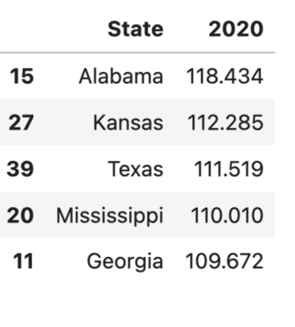
Cost of Living - Regional Price Parities (RPPs)
HIGHEST | 2018 | 2019 | 2020 | 2021
All Items |  |  |  | N/A
Goods
Housing
Utilities

Slide 31
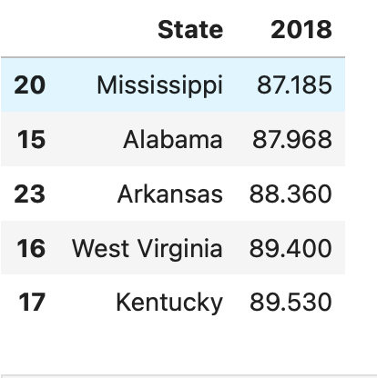
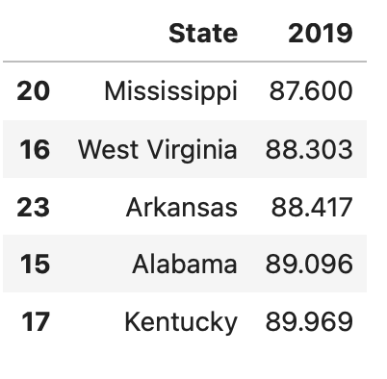
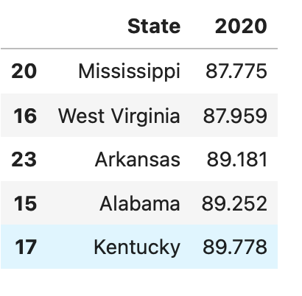
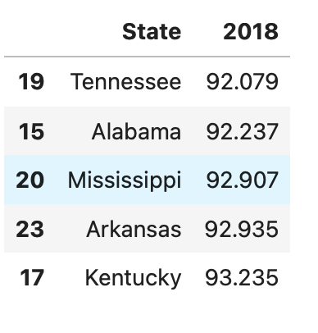
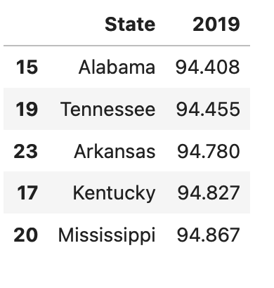
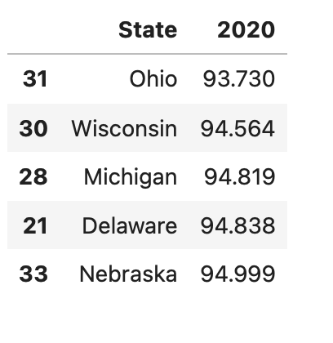
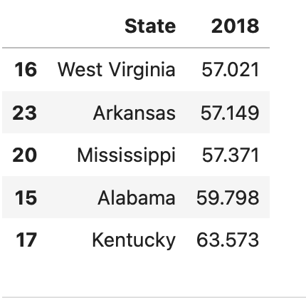
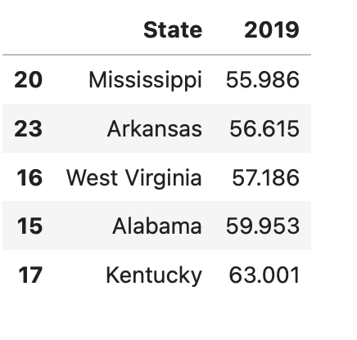
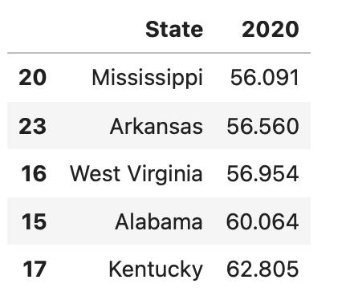
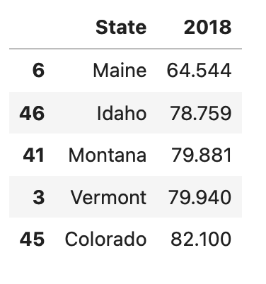
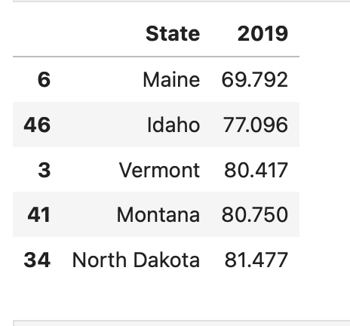
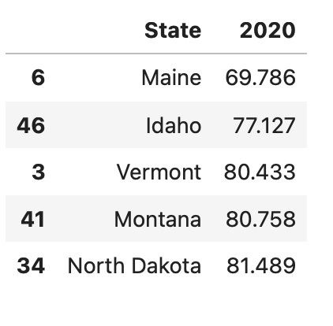
Cost of Living - Regional Price Parities (RPPs)
LOWEST | 2018 | 2019 | 2020 | 2021
All Items |  |  |  | N/A
Goods
Housing
Utilities

Slide 32
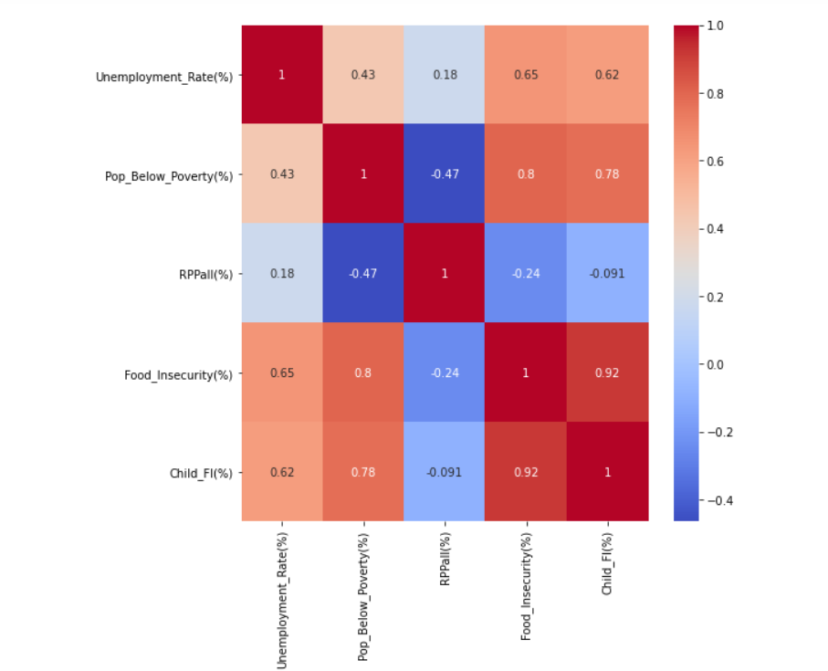
Correlation Heat Maps
2010

Slide 33
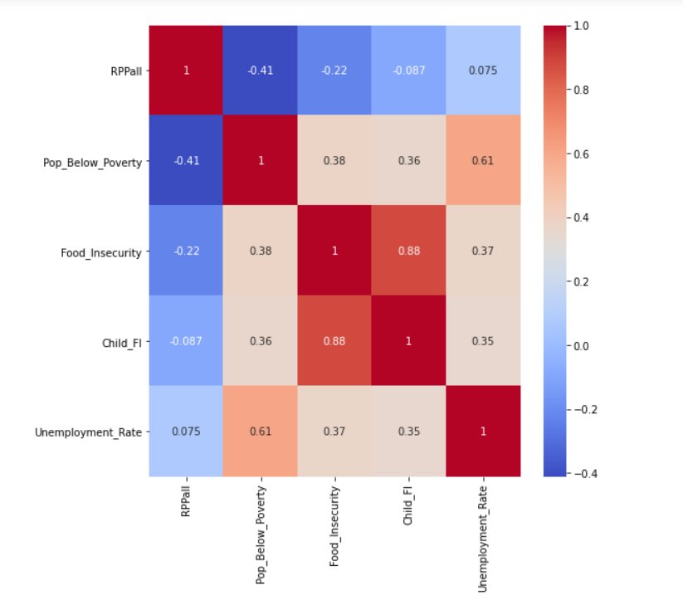
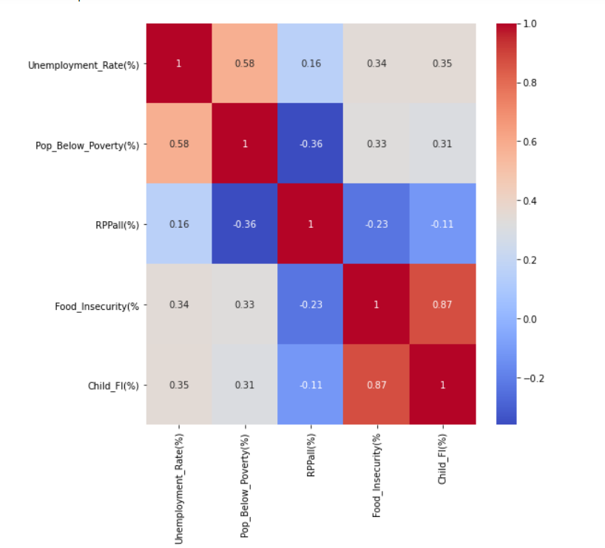
Correlation Heat Maps
2016
2017

Slide 34
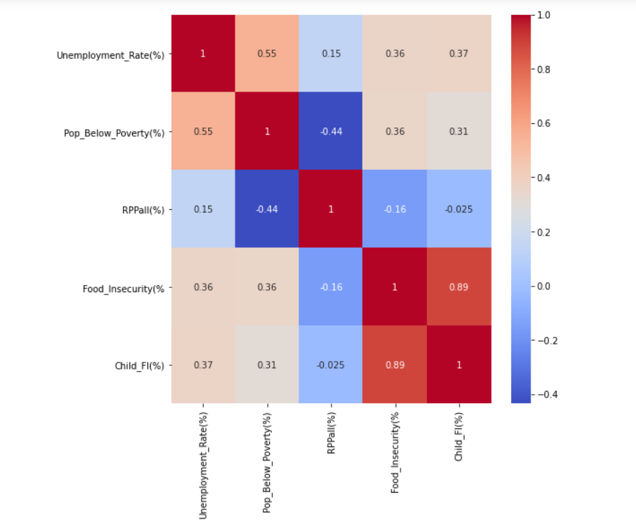
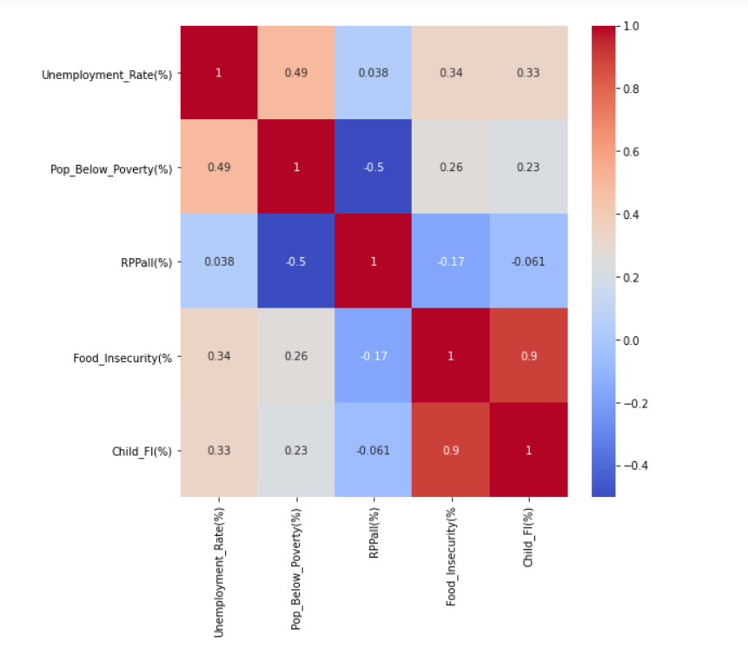
Correlation Heat Maps
2018
2019

Slide 35
Understanding the Market: What Other Outside Factors Affect Food Insecurity?

Slide 36




Unemployment Trends
TRADING ECONOMICS | U.S. BLS - UNEMPLOYMENT 25Y | * ALL RATES EXPRESSED AS A PERCENTAGE 5Y
1Y | 5Y - LABOR FORCE PARTICIPATION
Trading Economics, 2022

Slide 37




Other Relevant Trends
Agricultural Production | FEWSION * ALL RATES EXPRESSED AS A PERCENTAGE | USDA
Manufacturing | FRED | IHS MARKIT, JPMORGAN

Slide 38

Global Agricultural Production

Slide 39




Other Relevant Trends
Supply Chain Disruptions | AMERICAN SHIPPER | MAVROUDIS
Inflation | TRADING ECONOMICS | U.S. BLS | TRADING ECONOMICS | U.S. BLS

Slide 40

Red Flags For Future of Food Security in America?
Supply Chain Disruptions Caused by Current Events
Increasing Socioeconomic Disparities
1
3
2
Rising Inflation and Cost of Living
4
Increasingly Erratic Weather & Climate Change

Slide 41

Combating the Issue - Recommendations
Increase accessibility of resources for families and individuals seeking food/aid via local charities/organizations
Lowering mandatory age for drivers in all states down to 18 yrs for Class B driver certification, for them to gain experience and knowledge
1
3
Mr. Leo Servedio
Vice President at Teamsters Local 202
Bronx, New York
2
Require bonuses and incentive pay for truck drivers to be given up front at beginning of contracts with new trucking employees
4
Fund education programs directed at trade schools for truck driver students
Jon Samson, testifying on behalf of the American Trucking Association: “Nearly 1 million new drivers will need to be trained and hired in the next decade to keep pace with increase consumer demand and an aging workforce.” (Farm Progress, 2021)

Slide 42
Summary

Slide 43



Food Insecurity at optimal level in 2019 prior to COVID pandemic
Changes since 2019:
Food insecurity skyrockets in 2020/2021(45 million Americans of which 15 million are children)
Mass Trucking Retirement Movement(Equates to supply chain crisis), Inflation is at highest levels
Unemployment rates increased
Global supply chain pressures increase with little relief
COVID variants(Delta, Omicron)
Continuities:
Manufacturing recovered(U.S.)
Production recovered(U.S.)
Increase in knowledge of and access to resources via media(food stamps/food banks)
What Was Significant?:
Rapidly rising INFLATION(7.9% in Feb. 2022 - 40 year high)
Mass trucker retirement(mass distribution job openings caused supply chain problems)
Poverty increase
Rise in unemployment
Predictors: Unemployment, Inflation rate, Breaks in supply/distribution chain(labor shortages), Poverty

Slide 44
Conclusion

Slide 45

FOOD INSECURITY CAN AFFECT ALL AMERICANS!
Physical Development/Child Development
Education
Public Health
National Economy
More Obvious Contributors:
Unemployment increases
Inflation rate increases
Poverty rate increases
Less Obvious Contributors:
Lack of resources to obtain help
Supply/distribution chain breaks/shortages
Labor openings in supply/distribution chain
Unexpected Findings: Mass aging trucker retirement movement (over 244K people)
TAKE ACTION: Go Back to America’s Founding Industrial Roots
End bipartisan politics
Increase awareness of available resources (i.e., backpack programs)
Further American innovation to compensate for gaps in supply infrastructure (trucking and railway industry)

Slide 46
Thank you.

Slide 47
Questions?

Slide 48
References
6 Global Events That Have Disrupted the Manufacturing Supply Chain. Aptean.com. (n.d.). Retrieved March 24, 2022, from https://www.aptean.com/en-US/insights/blog/6-events-disrupted-maunfacturing-supply-chain
America's Health Rankings. 2022. Explore Food Insecurity in the United States | 2021 Health of Women And Children Report. [online] Available at: <https://www.americashealthrankings.org/explore/health-of-women-and-children/measure/food_insecurity_household> [Accessed 25 March 2022].
bls.gov. 2022. Economic News Releases. [online] Available at: <https://www.bls.gov/bls/newsrels.htm#OEUS> [Accessed 6 March 2022].
Buchholz, K. (2021, September 15). How did Covid-19 Spike U.S. Food Insecurity Levels? weforum.org . Retrieved March 24, 2022, from https://www.weforum.org/agenda/2021/09/united-states-us-food-insecurity-covid-pandemic-lockdown-coronavirus/
Coleman-Jensen, A., Rabbitt, M., Gregory, C., &amp; Singh, A. (2020, September). Household Food Security in the United States in 2019. ers.usda.gov. Retrieved March 24, 2022, from https://www.ers.usda.gov/webdocs/publications/99282/err-275.pdf
ers.usda.gov. 2022. History & Background. [online] Available at: <https://www.ers.usda.gov/topics/food-nutrition-assistance/food-security-in-the-u-s/history-background/> [Accessed 25 March 2022].
ers.usda.gov. 2022. Key Statistics & Graphics. [online] Available at: <https://www.ers.usda.gov/topics/food-nutrition-assistance/food-security-in-the-u-s/key-statistics-graphics/> [Accessed 25 March 2022].

Slide 49
References
Fatka, J., 2022. Trucker shortages plague food supply chain. [online] Farm Progress. Available at: <https://www.farmprogress.com/farm-policy/trucker-shortages-plague-food-supply-chain> [Accessed 25 March 2022].
Feeding America.org 2021. The Impact of the Coronavirus on Food Insecurity in 2020 & 2021. <https://www.feedingamerica.org/sites/default/files/2021-03/National%20Projections%20Brief_3.9.2021_0.pdf>
Feedingamerica.org. 2022. What is Food Insecurity? | Feeding America. [online] Available at: <https://www.feedingamerica.org/hunger-in-america/food-insecurity> [Accessed 7 March 2022].
Fred.stlouisfed.org. 2022. Manufacturing Sector: Labor Productivity (Output per Hour) for All Employed Persons. [online] Available at: <https://fred.stlouisfed.org/series/OPHMFG#0> [Accessed 21 March 2022].
Gerlock, G. (2017, April 9). Farmers look for ways to circumvent Tractor Software Locks. NPR. Retrieved March 25, 2022, from https://www.npr.org/sections/alltechconsidered/2017/04/09/523024776/farmers-look-for-ways-to-circumvent-tractor-software-locks
Global Manufacturing Production Growth Accelerates at end of 2021 as supply disruptions show signs of easing, price pressure cools. IHS Markit. (2022, January 5). Retrieved March 24, 2022, from https://ihsmarkit.com/research-analysis/global-manufacturing-production-growth-accelerates-Jan22.html

Slide 50
References
Gundersen, C., Waxman, E., Engelhard, E., Brown, J. Map the Meal Gap 2011: Food Insecurity Estimates at the County Level. Feeding America, 2011.
Gundersen, C., E. Waxman, E. Engelhard, T. Del Vecchio, & A. Satoh. Map the Meal Gap 2012: A Report on County and Congressional District Food Insecurity and County Food Cost in the United States in 2010. Feeding America, 2012.
Gundersen, C., E. Waxman, E. Engelhard, A. Satoh, & N. Chawla. Map the Meal Gap 2013: Food Insecurity Estimates at the County Level. Feeding America, 2013.
Gundersen, C., E. Engelhard, A. Satoh, & E. Waxman. Map the Meal Gap 2014: Food Insecurity and Child Food Insecurity Estimates at the County Level. Feeding America, 2014.
Gundersen, C., E. Engelhard, A. Satoh, & E. Waxman. Map the Meal Gap 2015: Food Insecurity and Child Food Insecurity Estimates at the County Level. Feeding America, 2015.
Gundersen, C., A. Dewey, A. Crumbaugh, M. Kato & E. Engelhard. Map the Meal Gap 2016: A Report on County and Congressional District Food Insecurity and County Food Cost in the United States in 2014. Feeding America, 2016.

Slide 51
References
Gundersen, C., A. Dewey, A. Crumbaugh, M. Kato & E. Engelhard. Map the Meal Gap 2017: A Report on County and Congressional District Food Insecurity and County Food Cost in the United States in 2015. Feeding America, 2017.
Gundersen, C., A. Dewey, A. Crumbaugh, M. Kato & E. Engelhard. Map the Meal Gap 2018: A Report on County and Congressional District Food Insecurity and County Food Cost in the United States in 2016. Feeding America, 2018.
Gundersen, C., A. Dewey, M. Kato, A. Crumbaugh & M. Strayer. Map the Meal Gap 2019: A Report on County and Congressional District Food Insecurity and County Food Cost in the United States in 2017. Feeding America, 2019.
Gundersen, C., A. Dewey, E. Engelhard, M. Strayer & L. Lapinski. Map the Meal Gap 2020: A Report on County and Congressional District Food Insecurity and County Food Cost in the United States in 2018. Feeding America, 2020.
Gundersen, C., Strayer, M., Dewey, A., Hake, M., & Engelhard, E. (2021). Map the Meal Gap 2021: An Analysis of County and Congressional District Food Insecurity and County Food Cost in the United States in 2019. Feeding America.

Slide 52
References
Isidore, C. (2021, May 29). Truckers are getting big pay hikes, but there's still a shortage of drivers. CNN. Retrieved March 24, 2022, from https://www.cnn.com/2021/05/29/economy/truck-driver-shortage-pay-hikes/index.html
Keiper, A. (2022, March 21). Russia's Ukraine War threatens to blow us food prices sky-high. Fox Business. Retrieved March 24, 2022, from https://www.foxbusiness.com/lifestyle/ukraine-war-russia-food-high
Nsf.gov. 2022. Multimedia Gallery | NSF - National Science Foundation. [online] Available at: <https://www.nsf.gov/news/mmg/> [Accessed 25 March 2022].
Preuss, L. (2018, September 27). Poverty and Food Insecurity Rates Improved in 2017, but 1 in 8 People Still at Risk of Hunger. hungerandhealth.feedingamerica.org. Retrieved March 24, 2022, from https://hungerandhealth.feedingamerica.org/2018/09/poverty-food-insecurity-rates-improved-2017-1-8-people-still-risk-hunger/
Regional Price Parities by State and Metro Area. Regional Price Parities by State and Metro Area | U.S. Bureau of Economic Analysis (BEA). (n.d.). Retrieved March 24, 2022, from https://www.bea.gov/data/prices-inflation/regional-price-parities-state-and-metro-area#:~:text=Regional%20price%20parities%20(RPPs)%20measure,the%20overall%20national%20price%20level
Sager, J. (2022, March 14). Here Are the Groceries You Might Be Missing On Store Shelves Due to Food Shortages In 2022 . Parade. Retrieved March 24, 2022, from https://parade.com/1332615/jessicasager/food-shortages-2022/#:~:text=%E2%80%9CIt%20is%20a%20combination%20of,Carl%20Marks%20Advisors%20told%20us.

Slide 53
References
Somwanshi, R., Anand, A., Kesavan, M., Singh, S., &amp; Samant, S. (2020, May 15). Infographic: Coronavirus pandemic tests global agriculture supply chain, Stokes Food Security Fears. S&amp;P Global Commodity Insights. Retrieved March 24, 2022, from https://www.spglobal.com/commodity-insights/en/market-insights/latest-news/agriculture/051520-infographic-coronavirus-pandemic-tests-global-agriculture-supply-chain-stokes-food-security-fears
Supply chain disruptions make a comeback. (n.d.). Www.mavroudis.com.cy. Retrieved March 25, 2022, from https://www.mavroudis.com.cy/news/supply-chain-disruptions-make-a-comeback#:~:text=According%20to%20the%20IMF%2C%20supply
The Barbecue Lab. 2022. Hunger in America | March 2022 | The Barbecue Lab. [online] Available at: <https://thebarbecuelab.com/hunger-in-america/> [Accessed 25 March 2022].
Tradingeconomics.com. 2022. United States Unemployment Rate - February 2022 Data - 1948-2021 Historical. [online] Available at: <https://tradingeconomics.com/united-states/unemployment-rate> [Accessed 8 March 2022].
Unemployment Rates During the COVID-19 Pandemic . (2021, August 20). Retrieved March 25, 2022, from https://sgp.fas.org/crs/misc/R46554.pdf
United States Inflation Rate. United States Inflation Rate - February 2022 Data - 1914-2021 Historical. (n.d.). Retrieved March 24, 2022, from https://tradingeconomics.com/united-states/inflation-cpi

Slide 54
References
U.S. Census Bureau. (n.d.). 2020 American Community Survey Estimates. data.census.gov. Retrieved March 24, 2022, from https://data.census.gov/cedsci/all?q=2020+ACS
U.S. Census Bureau. (2021, November 22). Income &amp; Poverty Publications. Census.gov. Retrieved March 24, 2022, from https://www.census.gov/topics/income-poverty/library/publications.html
U.S. Census Bureau. (2022, March 18). New Statistics Available From the 2016–2020 American Community Survey 5-Year Estimates. Census.gov. Retrieved March 24, 2022, from https://www.census.gov/newsroom/press-releases/2022/acs-5-year-estimates.html
USDA.gov. 2022. Productivity growth is still the major driver of U.S. agricultural growth. [online] Available at: <https://www.ers.usda.gov/data-products/chart-gallery/gallery/chart-detail/?chartId=58284> [Accessed 25 March 2022].
USDA.gov. 2022. Summary of Recent Findings. [online] Available at: <https://www.ers.usda.gov/data-products/agricultural-productivity-in-the-u-s/summary-of-recent-findings/> [Accessed 21 March 2022].

